Slide 1
TRIVIA TASTIC!
Steve Hulme
Emmanuel Mosqueda
Jamal Patterson
John Carroll
November 18, 2017

Slide 2
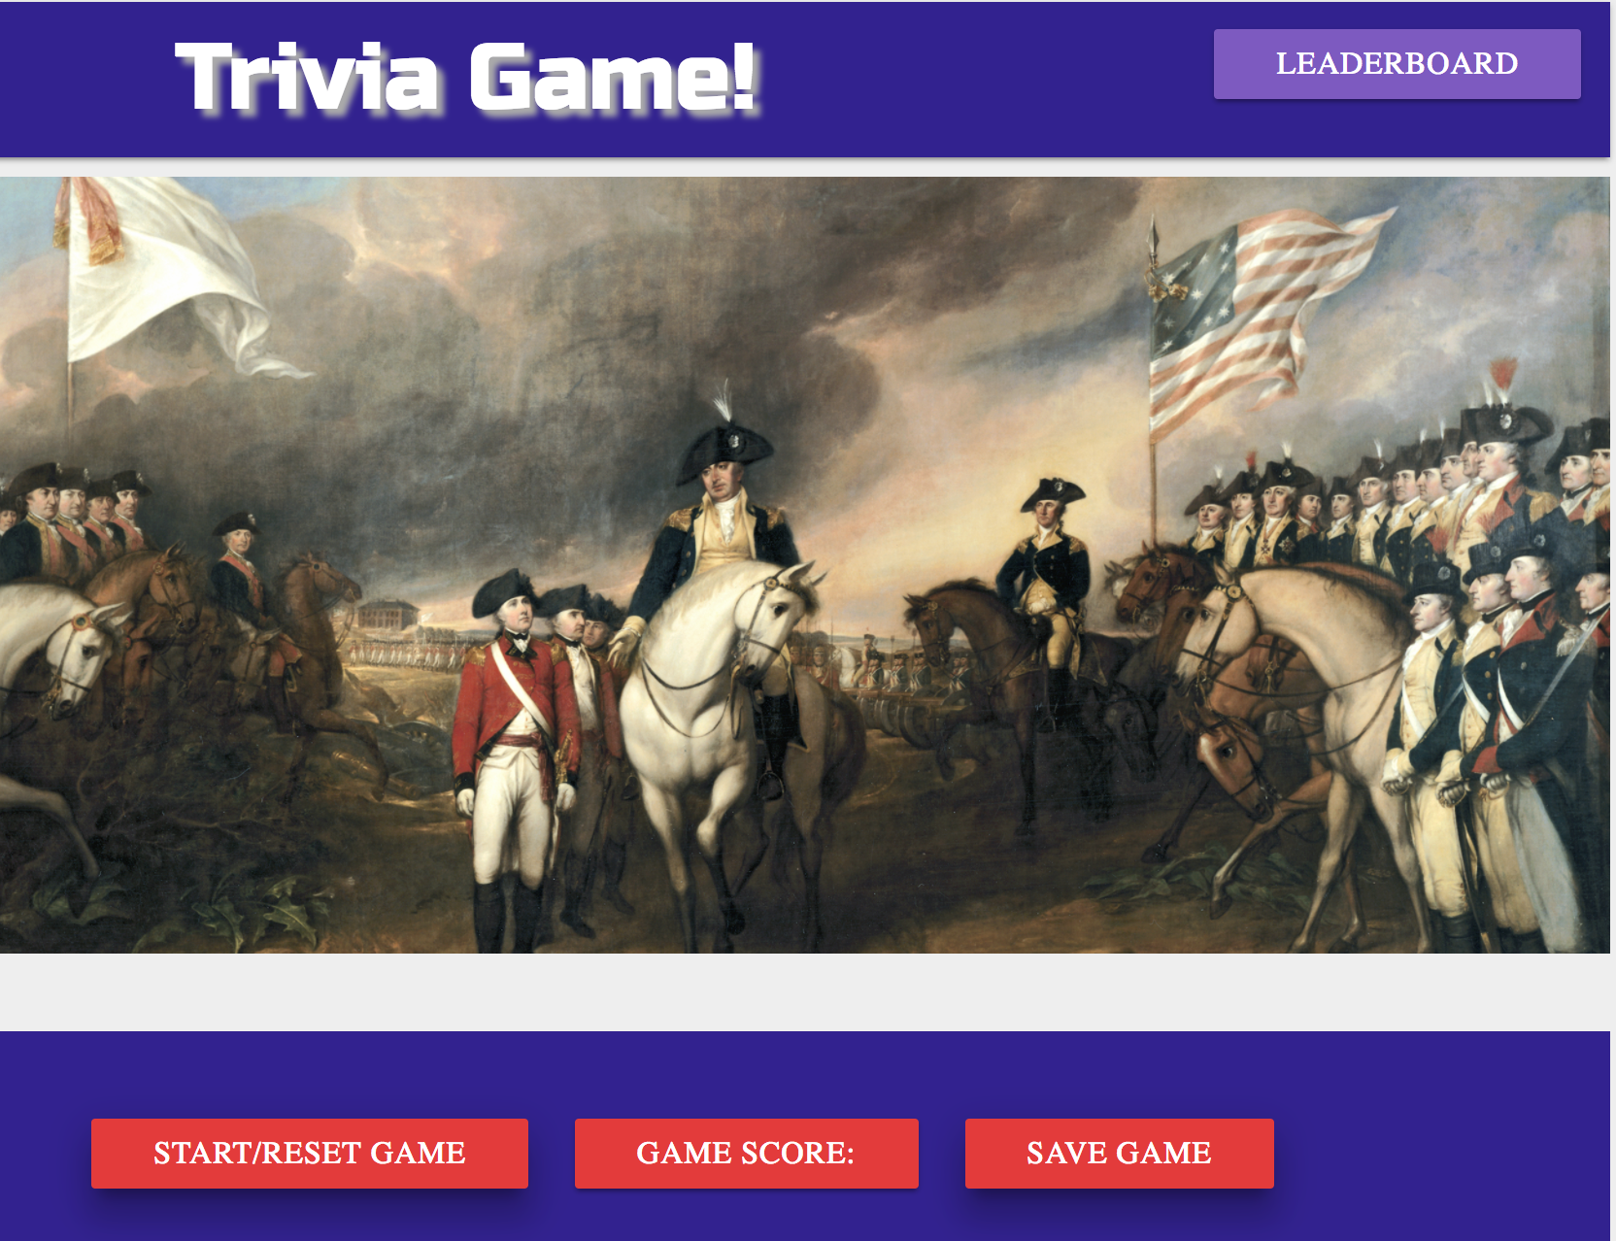
Non-Trivial Technology!
Jamal – Pictures to match questions -- Pixabay!
Steve – Triivia Questions --Open TDB and Javascript
John – LeaderBoard –Firebase.
Emmanuel – User Interface and Design – Materialize!

Slide 3
Project Challenges
API Challenges: Finding an API to display paintings to match the question list.
Dealing with unfound results and how to handle errors.
Integrating the image API into the preexisting OpenTDB API.
Dealing with non-English characters in the Open Trivia DB.

Slide 4
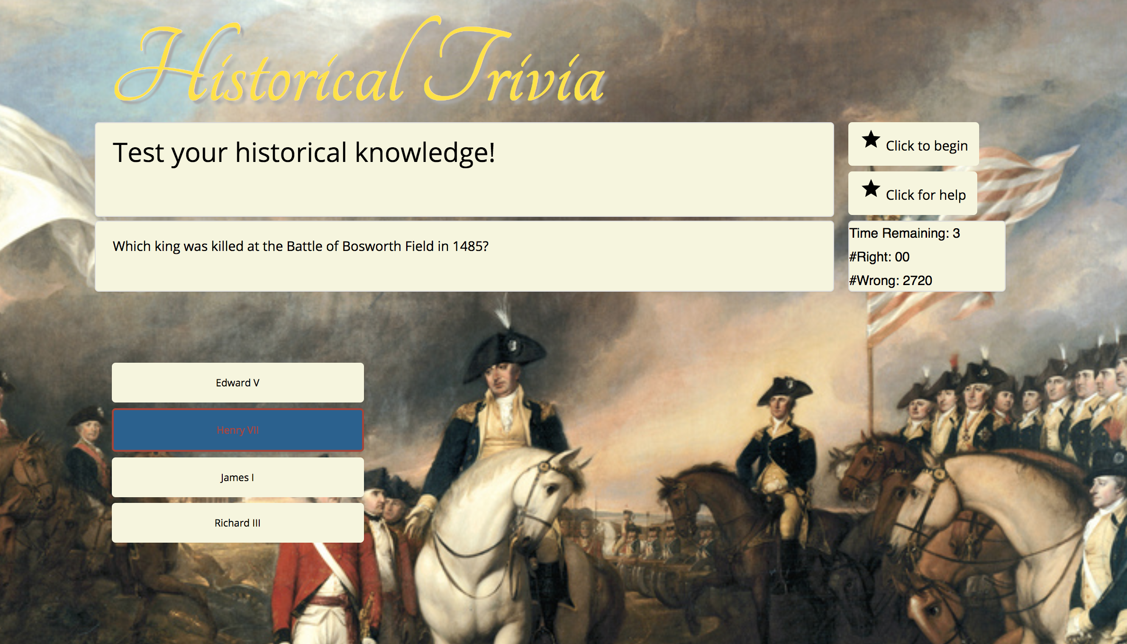
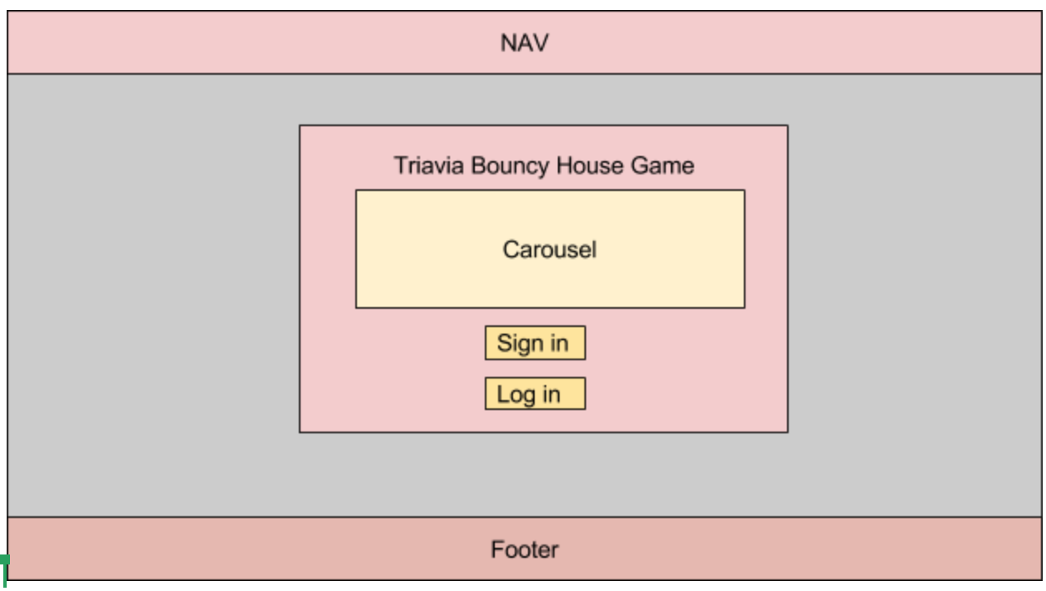
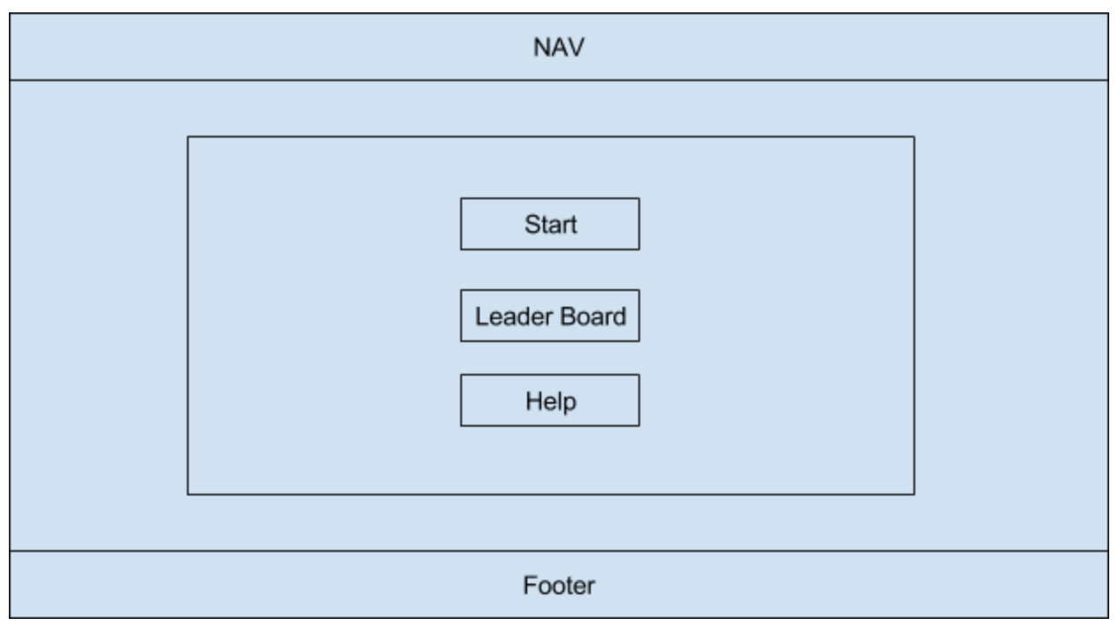
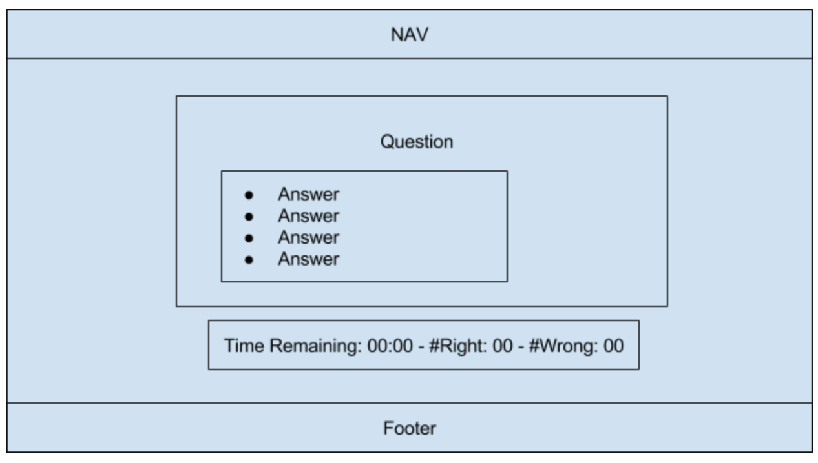
UI Wire Frame

Slide 5
Codebase
Steve’s Trivia Homework was the code base.
But it lacked
Persistence
Compelling UI
Relevance of background to the question being asked
Scoring
Power of synergy

Slide 6
API
Open Trivia Database
Crowd-sourced questions
Pixabay
Match background to the question – automagically!

Slide 7
Leaderboard
Firebase for Persistence
Looking for retro game feel

Slide 8
Future Development
Multi-player Mode
Compete against each other and against the clock
Select Trivia Category
Open TDB has 23+ categories
Wider Selection of questions within category
Interface to add questions to Open TDB

